Slide 1
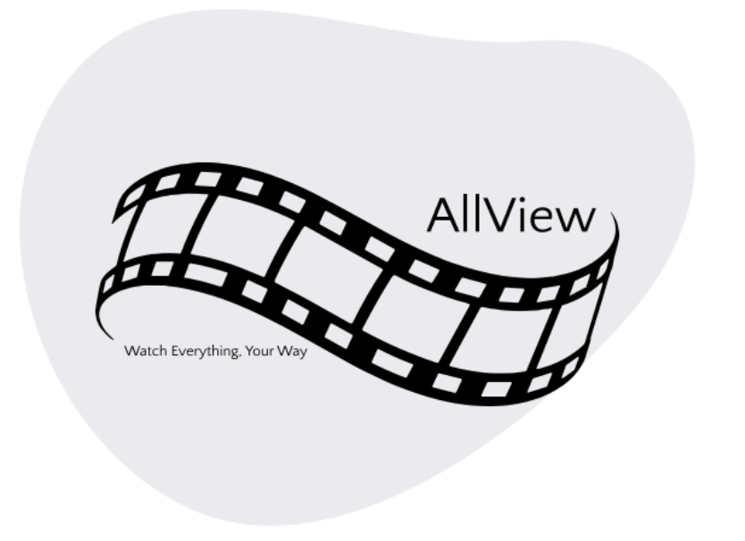

Slide 2
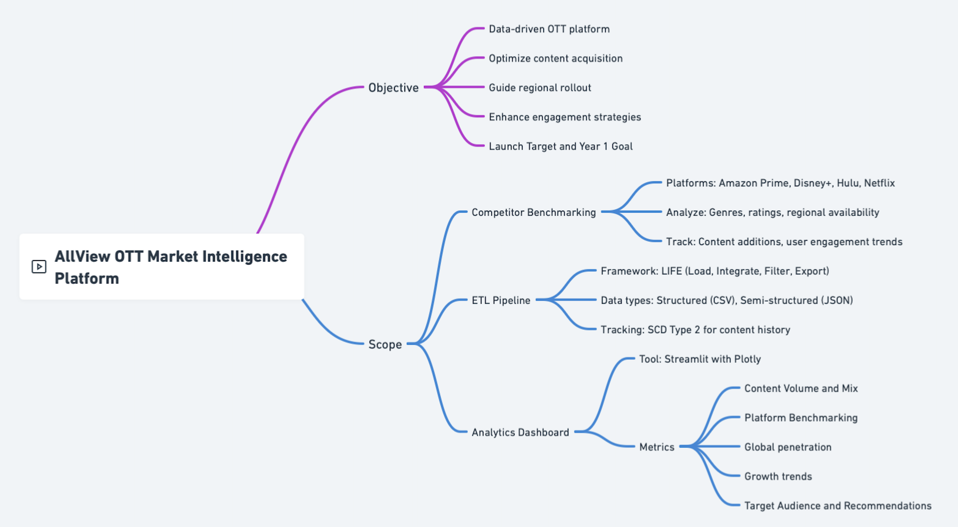
Functional Overview

Slide 3
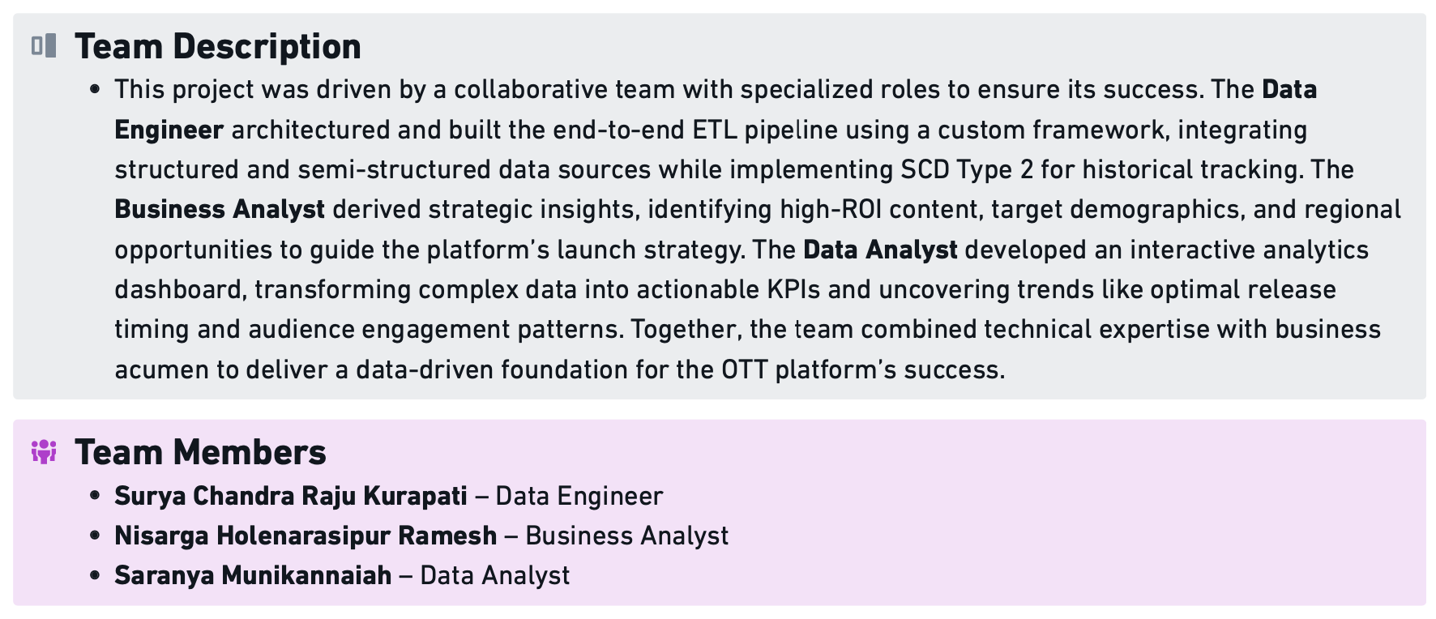
Team

Slide 4
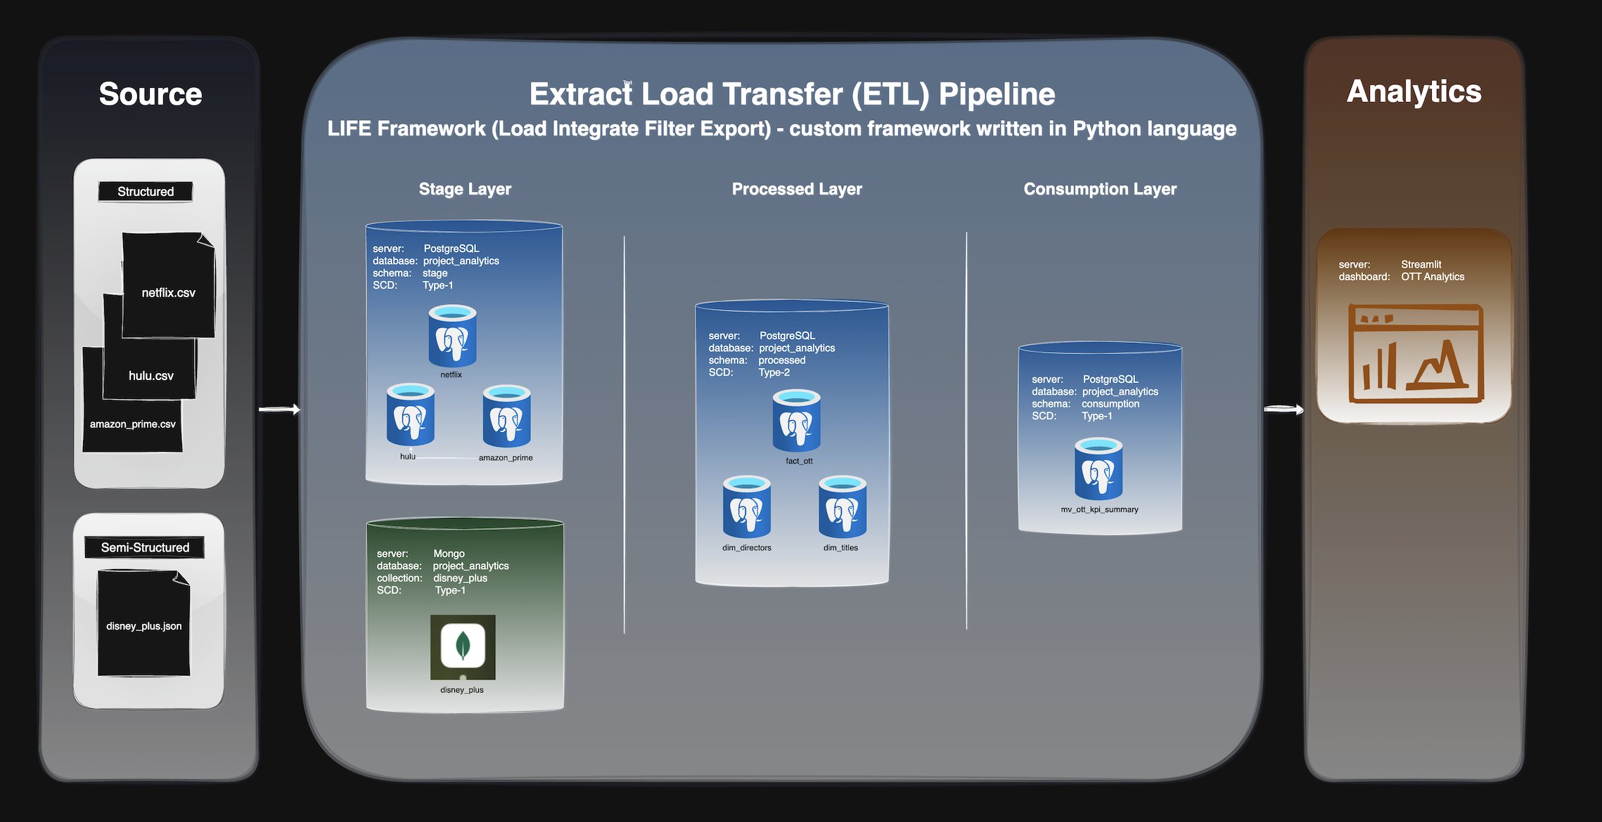
Technical Overview

Slide 5
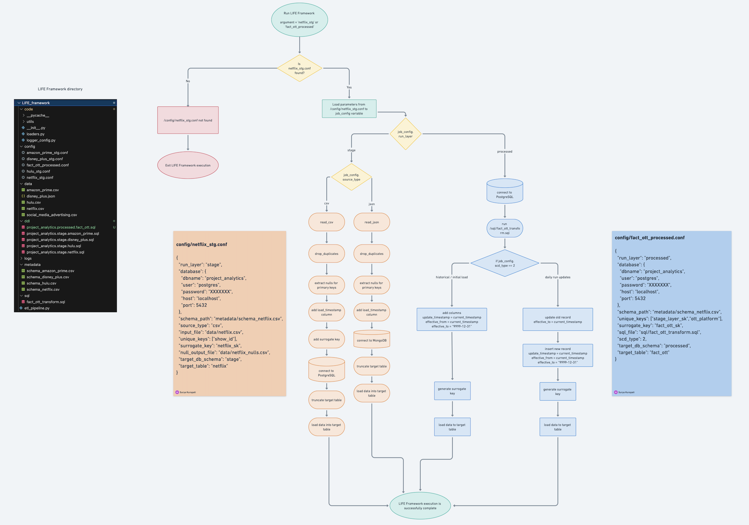
LIFE Framework – Load Integrate Filter Export
A custom Python ETL framework for streamlined data integration and transformation

Slide 6
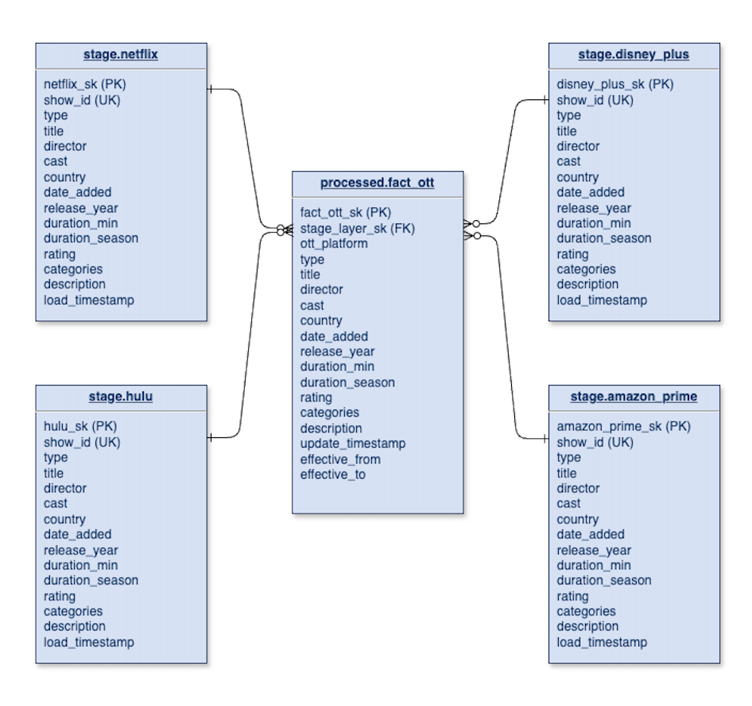
Data Model
An Entity-Relation model

Slide 7
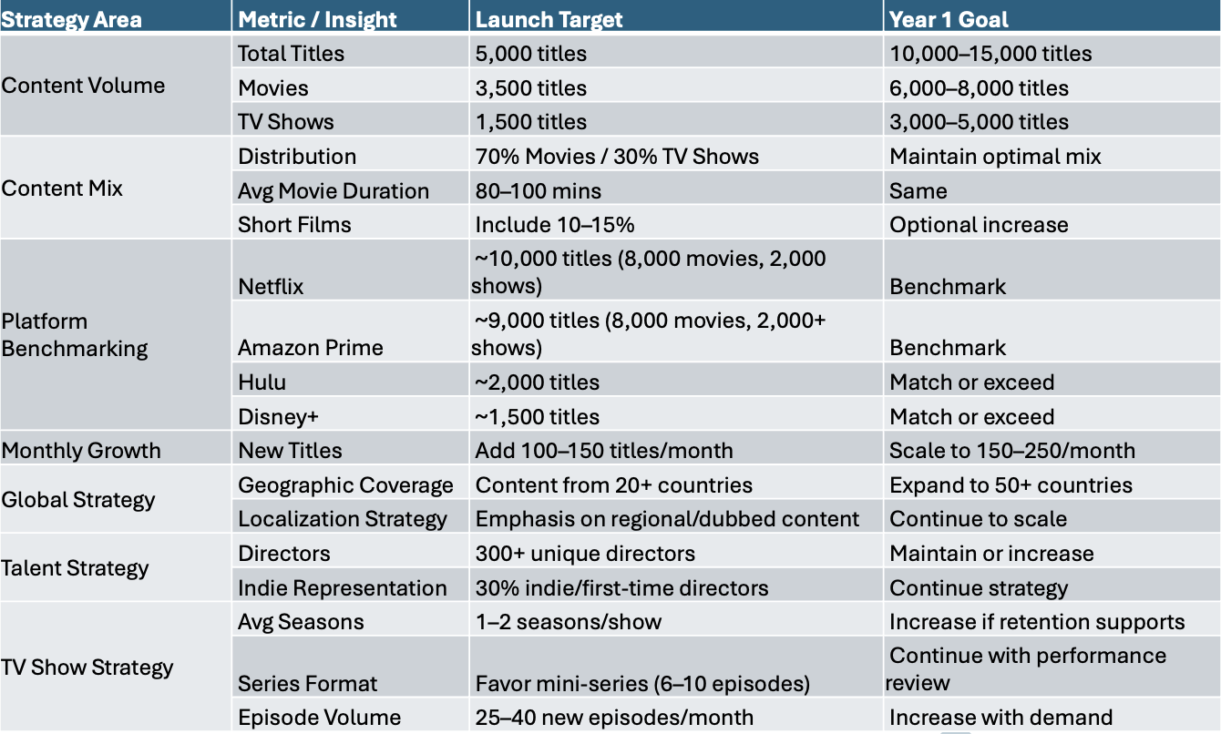
Insights and Strategic Targets

